Slide 1
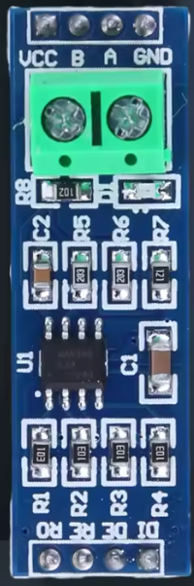
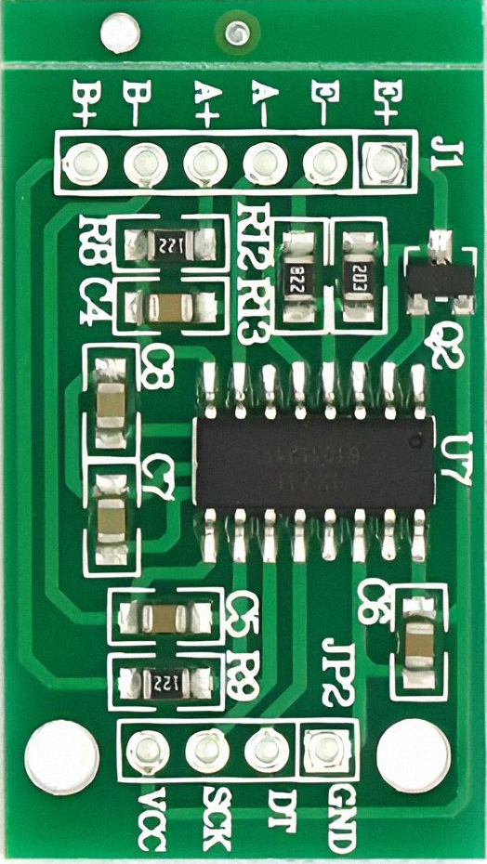
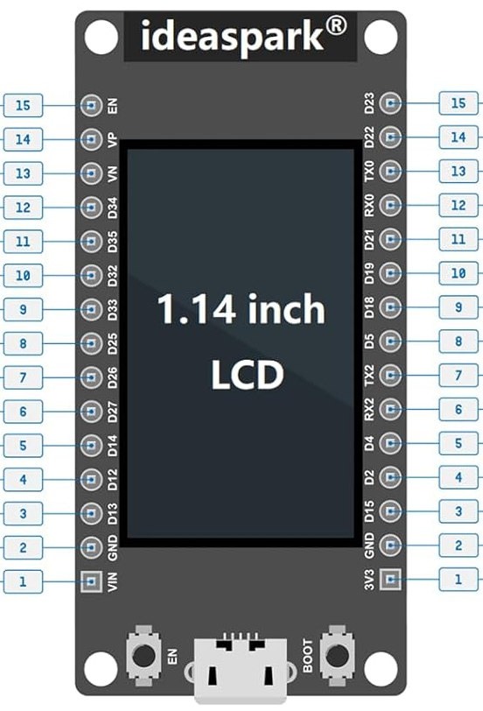
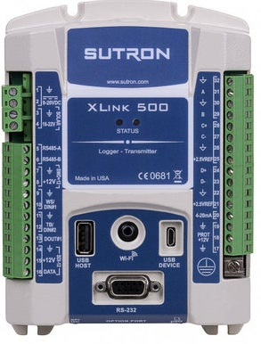
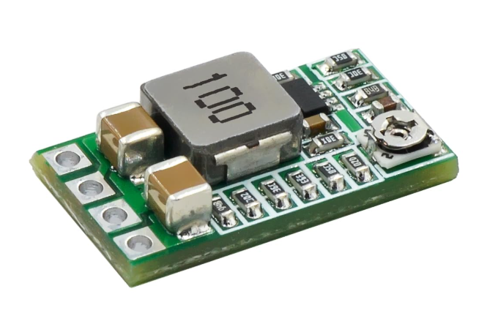
SCALE

Slide 2
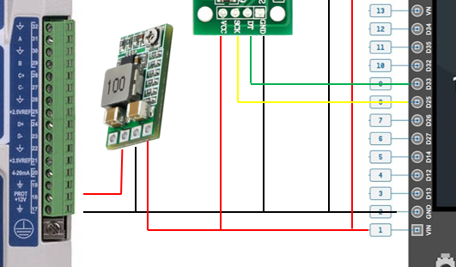
Power Supply
Mini DC-DC 12-24V to 5V 3A Step Down Buck Power Module
Adjustment screw: change to output 5V
Verify with meter
Mini DC – DC | Connected to:
EN | Not Used
IN+ | Xlink500 Port 18 (12V pos)
GND | Xlink500 Port 19 or 17 (12V neg) ESP Pin 2 (GND) HX711 GND MAX 485 GND
V0+ | ESP32 Pin 1 (Supply 5V for ESP32) HX711 VCC MAX485 VCC
EN IN+ GND V0+
https://www.amazon.com/dp/B0CDWW4XHL?ref=ppx_yo2ov_dt_b_fed_asin_title

Slide 3
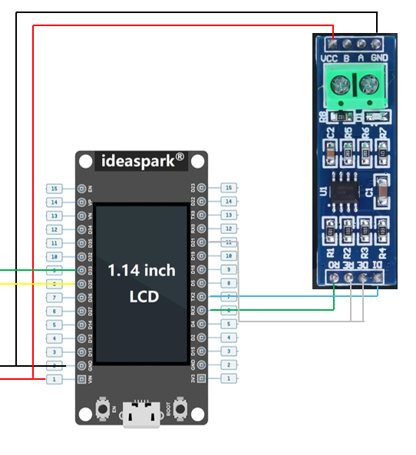
MAX485 Module
Modbus comm ESP32 to Sutron
MAX485 | Connected to:
VCC | 5.5V +
B | Sutron RS485-A (via block terminal)
A | Sutron RS485-B (via block terminal)
GND | 5.5V -
MAX485 | Connected to:
RO | ESP32 pin R7 (TX2)
RE | ESP32 pin R11 (D21)
DE | ESP32 pin R11 (D21)
DI | ESP32 pin R6 (RX2)
https://www.amazon.com/ANMBEST-Transceiver-Arduino-Raspberry-Industrial-Control/dp/B088Q8TD4V/ref=sr_1_3?crid=OACU5IWAMFFV&dib=eyJ2IjoiMSJ9.XOz9FiFG1jgK1-6pnXbdu7lC8cw7WnbkjiGvImx0leVrIttG0RHSJrwm5iyhbcH2uTFJiUEgbMUvTEKyt6YQJh4BXnZtY92ZFOAYZ8v6Bc2gIKrCIWYCfTiC68pG9ZGuViQ0dCUp_99NhMVQWh_w1YvLyVHoKvJ1ryN6nIXYhE1b1p8AS5cialWWZsdSCDOiuUYnGP1WnfDbjqt2I6vM2UlEK64-AIN9yz6vEKVH6-o.1mdE9VvUY0gWjrbshtmukpw0mZpPO0Uivx23_dCgARs&dib_tag=se&keywords=Max485&qid=1770337164&sprefix=max48%2Caps%2C267&sr=8-3

Slide 4
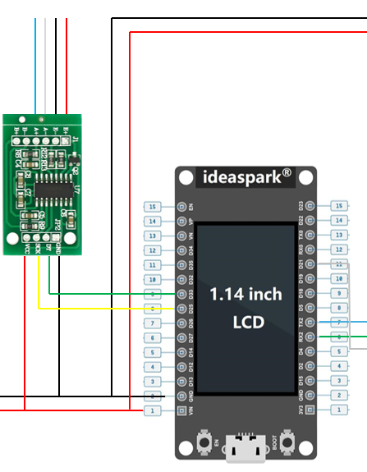
HX711 Load Cell Amplifier 24-Bit ADC
SCALE
HX711 | Connected to:
E+ | Red (Excitation voltage, 5.5V+)
E- | Black (Excitation voltage, 5.5V-)
A- | White
A+ | Blue (or Green on some scales?)
HX711 | Connected to:
VCC | 5.5V +
SCK | ESP32 Pin L8, D25
DT | ESP32 Pin L9, D33
GND | 5.5V -
https://www.amazon.com/WWZMDiB-HX711-Amplifier-Displacement-Acceleration/dp/B0BLND4VF6/ref=sr_1_3_pp?crid=C0181XBADPO9&dib=eyJ2IjoiMSJ9.dKKd_rVo-1xsjxMNARcrsPDNlovI00kewsuYFiCeeM6o8mk5BFmvWcG_IfBNpGlivmn1nUjsOteC9DGdFfVZiaOdYx1_VpfR3NQP6dKYvaD8Iqkl215_q75TYVnLycWNz56sUcgAzVmg7RCtGPSKhsTZlK0QucP4II9HaDSgl84c6f7INv29nOxjedMD2dkegcPtDTDdtN4Zuyk7Xb7Ky6lTZg4dUAWcr0i9ieLdhgM.64kGX__zs8UzYpb3eWF047CEWY5AtGevGsWqjAO44aU&dib_tag=se&keywords=HX711+module&qid=1770337779&sprefix=hx711+modul%2Caps%2C216&sr=8-3

